Slide 1
BitBucket Essentials for Git
Key Operations and Concepts
8 May 2024, Speaker name

Slide 2
Initializing a New Git-BitBucket Repo
1. git init Command:
Initializes a new Git repository.
Creates a .git directory in the current folder containing all repository files.
2. Creating a Repository on BitBucket:
Log in to BitBucket and navigate to the "Create repository" page.
Fill in the repository name and other details.
Click "Create repository".
3. Connecting Local Repo to BitBucket:
After initializing the local repo, connect it to the BitBucket remote repository using:
git remote add origin https://bitbucket.org/username/repository-name.git
Verify the connection with:
git remote -v

Slide 3
Pulling from Git-BitBucket: Pull
1. Explanation of git pull:
Fetches and integrates changes from the remote repository into the current branch in one step.
2. Command Usage and Example:
Basic usage: git pull origin main
This command fetches changes from the main branch of the remote repository origin and merges them into the current branch.

Slide 4
Pulling from Git-BitBucket: Fetch
1. Explanation of git fetch:
Fetches changes from the remote repository but does not merge them into the current branch.
Updates the remote tracking branches in your local repository.
2. Command Usage and Example:
Basic usage: git fetch origin
This command fetches all the branches and their changes from the remote repository origin.

Slide 5
Pulling from Git-BitBucket: Merge and Rebase
1. Explanation of git merge:
Combines changes from one branch into another.
Creates a new commit that includes the changes from both branches.
2. Explanation of git rebase:
Moves or reapplies commits on top of another base commit.
Avoids creating a merge commit, resulting in a linear project history.
3. When to Use Each Command:
Merge is useful for preserving the complete history of changes and context.
Rebase is useful for maintaining a clean and linear history.
Base
New Merge Commit
New Main with new features
Base
Main

Slide 6
Difference Between Pull, Fetch & Rebase
1. git pull vs. git fetch:
git pull = git fetch + git merge
git fetch downloads changes but doesn't integrate them.
git pull both downloads and merges changes.
2. git fetch vs. git rebase:
git fetch only updates your local copy with remote changes.
git rebase reapplies your local commits on top of the fetched commits.
3. Key Scenarios:
Use git fetch to see changes without affecting your working directory.
Use git pull to fetch and merge changes.
Use git rebase to clean up your commit history.

Slide 7
Push to Git-BitBucket
1. Explanation of git push:
Uploads local repository content to a remote repository.
Transfers commits from your local repository to the remote repository.
2. Command Usage and Example:
Basic usage: git push origin main
This command pushes your commits to the main branch of the remote repository origin.

Slide 8
Understanding Git Commit
What is git commit?
The git commit command is used to save changes to the local repository.
It records a snapshot of the project's currently staged changes.
Key Points:
Commit Message: Descriptive message explaining what changes were made.
Example: git commit -m "Add new feature X"
Staging Area: Ensure files are staged using git add before committing.
Example: git add . or git add <file>
Creating a Commit:
Example: git commit -m "Your descriptive commit message"
Viewing Commit History: Use git log to see a list of past commits.
Best Practices:
Meaningful Messages: Write clear and concise commit messages.
Frequent Commits: Commit small, logical chunks of work frequently.
Review Changes: Use git status and git diff to review changes before committing.
WorkSpace (Local)
Git add (Stagging)
Repository (Commit)

Slide 9
Git Cherry-Pick
Explanation of git cherry-pick:
Applies the changes introduced by existing commits to another branch.
Useful for selectively applying specific changes without merging entire branches.
Command Usage and Example:
Basic usage: git cherry-pick <commit-hash>
This command applies the changes from the specified commit to the current branch.
Main
Commit
Added features
Cherry-Pick
Added features

Slide 10
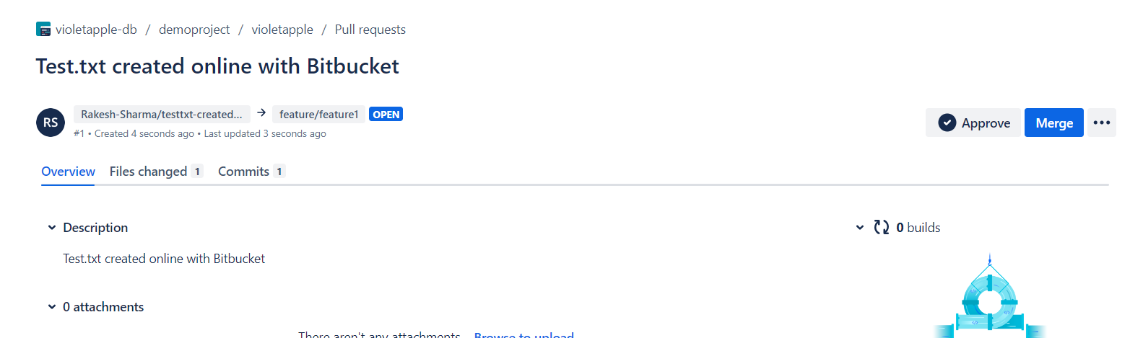
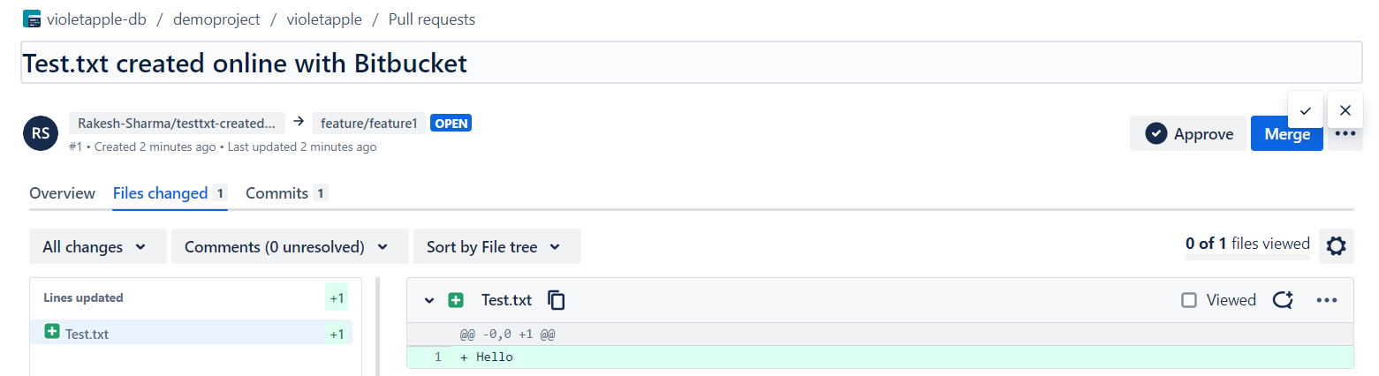
Git Pull Request

Slide 11
Git Undo
1. Common Undo Commands:
git reset
Moves the current branch pointer to a specified commit.
Can un-stage changes or remove commits.
git revert
Creates a new commit that undoes the changes from a previous commit.
Keeps the history intact.
git checkout
Switches branches or restores files to a previous state.
Can be used to discard changes in the working directory.
2. When to Use Each Command:
Use git reset to un-stage changes or move the current branch back.
Use git revert to undo commits without losing history.
Use git checkout to switch branches or discard local changes.

Slide 12
Thank you
8 May 2024, Speaker name

